Slide 1
Death Flies In On A Breeze
Chris Landau (Geologist)
June 22, 2010

Slide 2
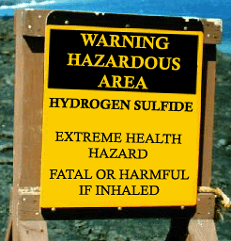
Hold Your Breath
Your Life May Depend On It

Slide 3
BP’s Chemical Warfare Gases
& Carcinogen Soup
Broken Promises (BP) well spews the lethal and carcinogenic gases of hydrogen sulfide, sulfur dioxide and benzene.

Slide 4
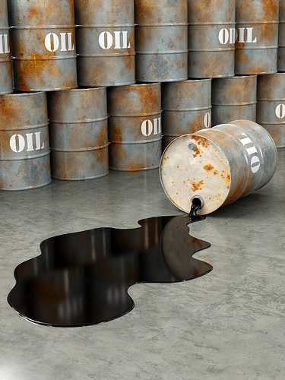
There are 3 deadly gases blowing across the Gulf of Mexico, from the BP-Transocean-Halliburton blow out well towards the land.
These gases are a direct result of the oil gusher, natural gas gusher and the faults within the Earth itself.

Slide 5
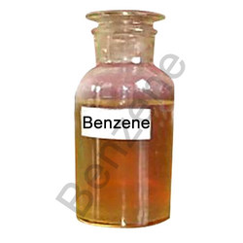
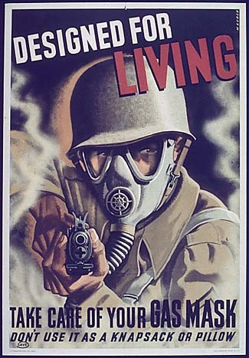
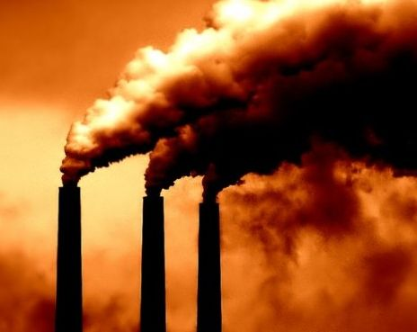
They Are…
Benzene, a carcinogenic compound found in crude oil. It is one of the two hundred approximate chemicals included in oil and is also found in our gasoline tanks.
Hydrogen Sulfide, a deadly gas, used in World War One, to kill soldiers when chemical warfare reached its peak. This gas is found in natural gas which is 95% methane and in small quantities within crude oil and in volcanoes and fault lines.
Sulfur dioxide. A chemical found in small quantities in the Earth, but increased by the flaring (burning) of natural gas and oil when hydrogen sulfide is converted or oxidized to sulfur dioxide.

Slide 6
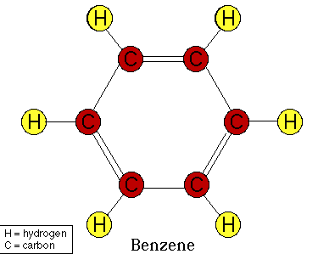
Why Are These Gases & Liquids So Bad?
Benzene is a volatile (vaporizes easily) organic compound that becomes a liquid at 42 F and boils away completely at 176 degrees F. It is carcinogenic and causes leukemia and cancer at 1 part per million, in air (3.19 mg benzene per cubic meter of air) At 500 parts per million, it is immediately dangerous to life and health. One part per million is like being one star in a million, but that tiny amount is enough to cause cancer.
It is lighter than water and floats with a density of 0.8765 grams per cubic centimeter. At 20000 ppm, or 2% by volume in the atmosphere, it causes death.
1.

Slide 7
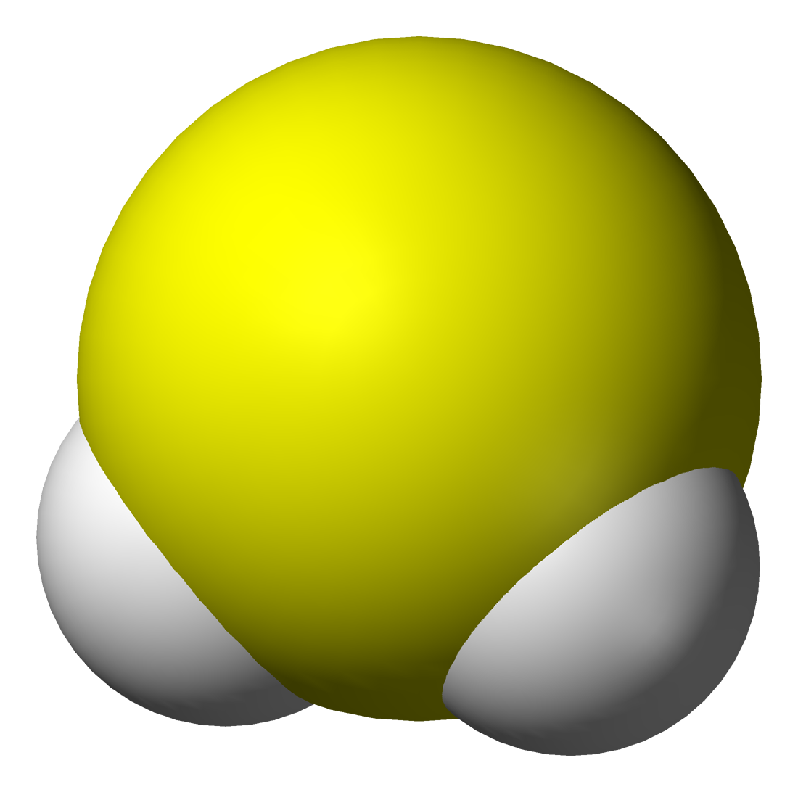
2.
Hydrogen sulfide smells like rotten eggs. It is a liquid at -122 F and a gas at -77 F. When it is a gas, it is heavier than air and denser than air. It weighs 1.36 grams per liter compared with air which weighs 1.225 grams per liter. It can cause injuries or death when it pools in hollows. At 100 parts per million, it is immediately dangerous to life and health. A person can only work for about 10 minutes at the permissible exposure limit of 20 ppm. At 150 ppm, a person can no longer smell hydrogen sulfide. At 500 ppm it causes pulmonary edema (fluid build up in lungs) and possible death. At 800 parts per million 50% of humans die for a 5 minute exposure. At 1000 parts per million a single breath causes breathing to stop and death to occur.

Slide 8
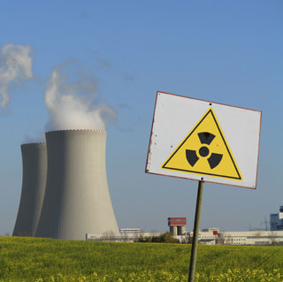
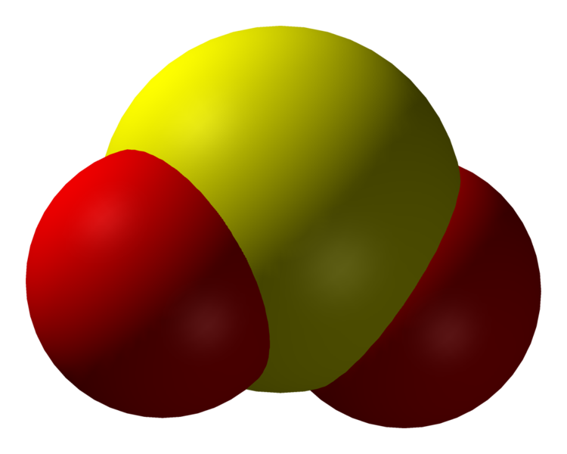
3.
Sulfur dioxide smells like rotten eggs. It is heavier than air at 2.77 grams/per liter. The permissible exposure limit for sulfur dioxide is 5 ppm. It is immediately dangerous to life and health at 100 ppm. It is a liquid at -104 F and a gas at 14 F. It leaves an irritating taste in the mouth at 0.3 ppm -1 ppm. It causes pulmonary edema(fluid build up in lungs) and 50 % of a rat population will die at 2520 ppm.

Slide 9
How Do You Know The Deadly Gas
Or Liquid Is There?
1) Benzene’s odor can be detected at 1.5 parts per million (ppm). Its taste detection limit is 2 ppm.
2) Hydrogen sulfide’s odor is detected at 0.5 parts per BILLION (ppb). Rotten egg smell.
3) Sulfur dioxide’s odor and taste can be detected at 0.3-1 (ppm) parts per million.

Slide 10
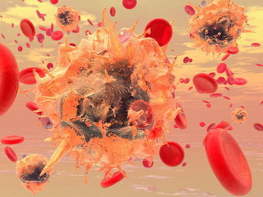
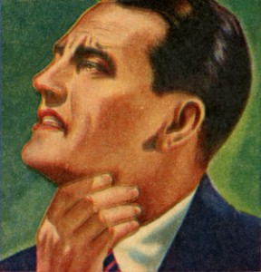
What Is A Safe Working Amount
For These 3 Chemicals In ppm?
Benzene causes cancer and leukemia in people when long term exposure of benzene exceeds one part per million of benzene molecules to air molecules.
Hydrogen sulfide causes eye irritation at 10- 20 parts per million of air. At 50ppm it causes eye damage. At 100 ppm, one stops smelling it and at 350 ppm pulmonary edema sets in causes a suffocation effect from fluid build up. This leads to death.
Sulfur dioxide is deadly when sulfur dioxide reaches 5 parts per million in the air. It causes throat irritation.

Slide 11
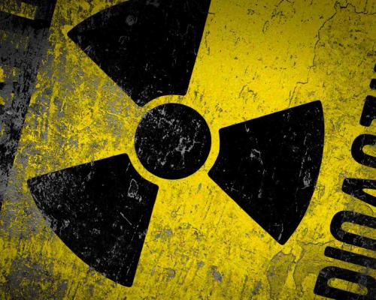
Gas Detectors Need To Be Instituted
Detectors need to be set up around the Gulf of Mexico to measure these 3 gases individually. The EPA has begun publication of benzene and some aromatics in tables on their web site in mid June 2010. Before this date, for April and May, only hydrogen sulfide and all volatile organic concentrations were being published as one group. We need to test individually for:
1) Benzene
2) Hydrogen Sulfide
3) Sulfur Dioxide
These gases are deadly and therefore should not be classified along with many of the other volatile organic compounds.
We know hydrogen sulfide is already being detected at up to 2 ppm. We know eye irritation will set in at 10 ppm and eye damage at 50ppm. Asthmatics and sensitive persons might be affected earlier or at lower concentrations.

